Slide 1

College Scorecard Analysis
YiHui ho

Slide 2
Goal:
Is Duquesne university a good school?
What factor can we control?
What is Duquesne’s performance vs expectation?
How can we improve relative to whom?
How can we control our input in order to improve our output?

Slide 3
Define Good School
Student success is defined as the average salary students make three years after their college graduation.
Bad: Student income < Median income from the data
Good: Student income > Median income from the data

Slide 4
Result
Method: Logistic Regression with 82% accuracy
Duquesne university is a good school

Slide 5
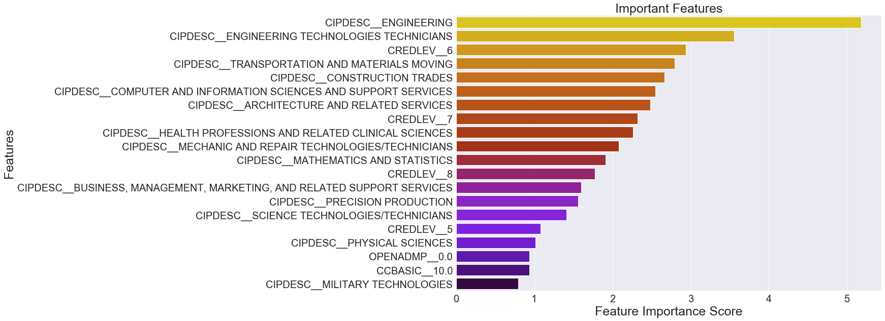

Slide 6
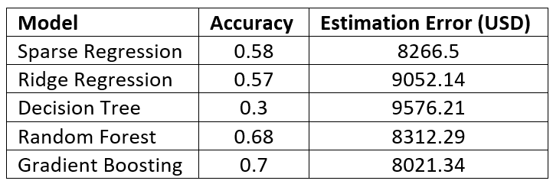
Income Prediction

Slide 7
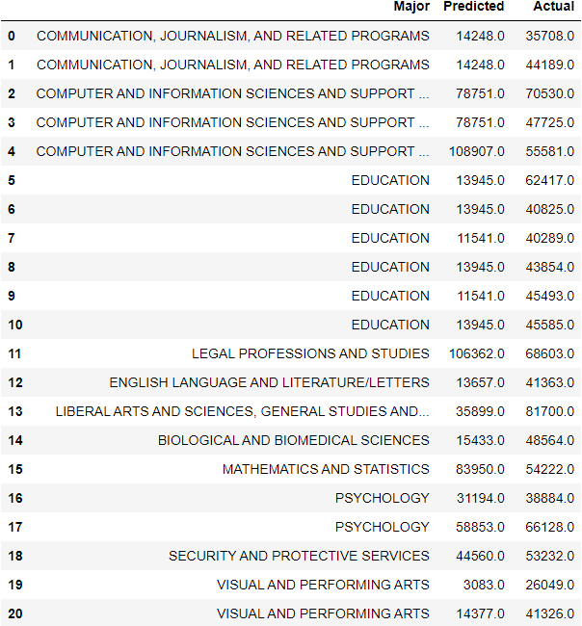
Predicted V.S. Actual

Slide 8
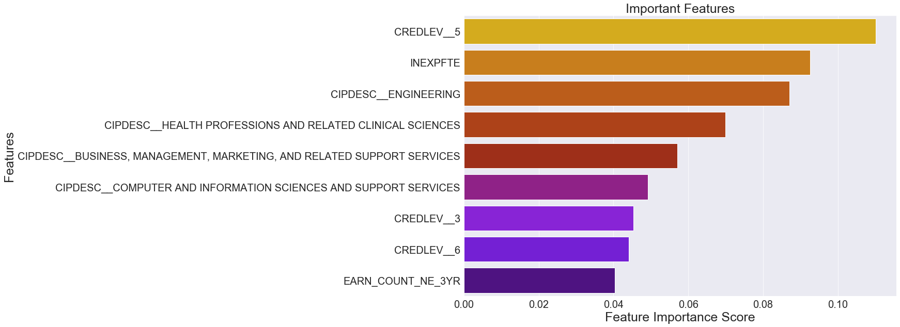

Slide 9
Conclusion
Be a better school:
Increasing engineering – related major
Increasing master degree program

Slide 10


